Slide 1
Comparing the Resilience of Industries in the Space Economy
Marianne Baquero, Srinidhi Bijjala, Jiya Gupta, Khushi Hisaria
Notes:
Khushi

Slide 2
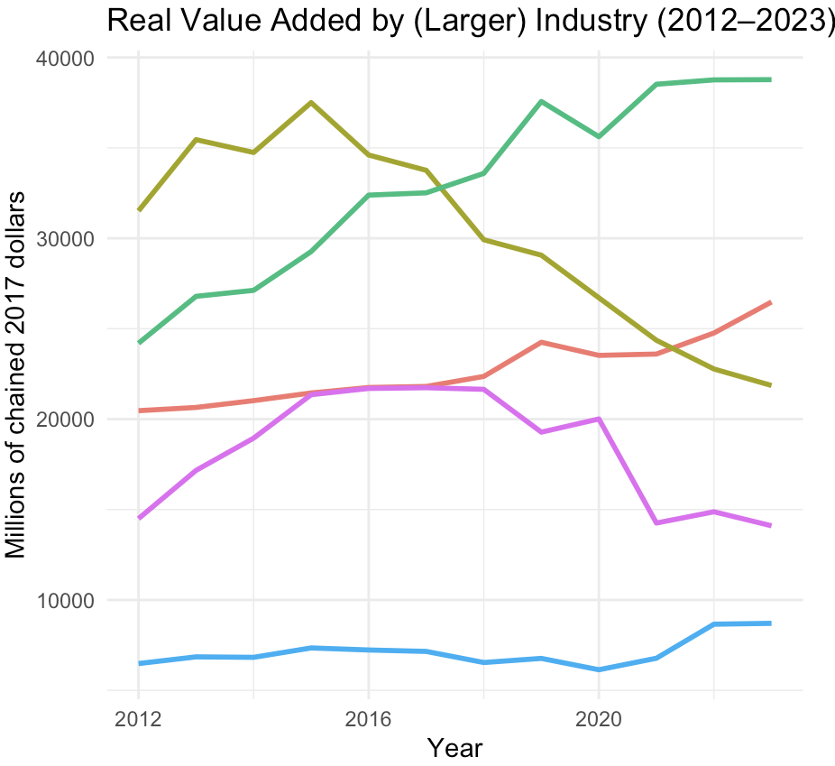
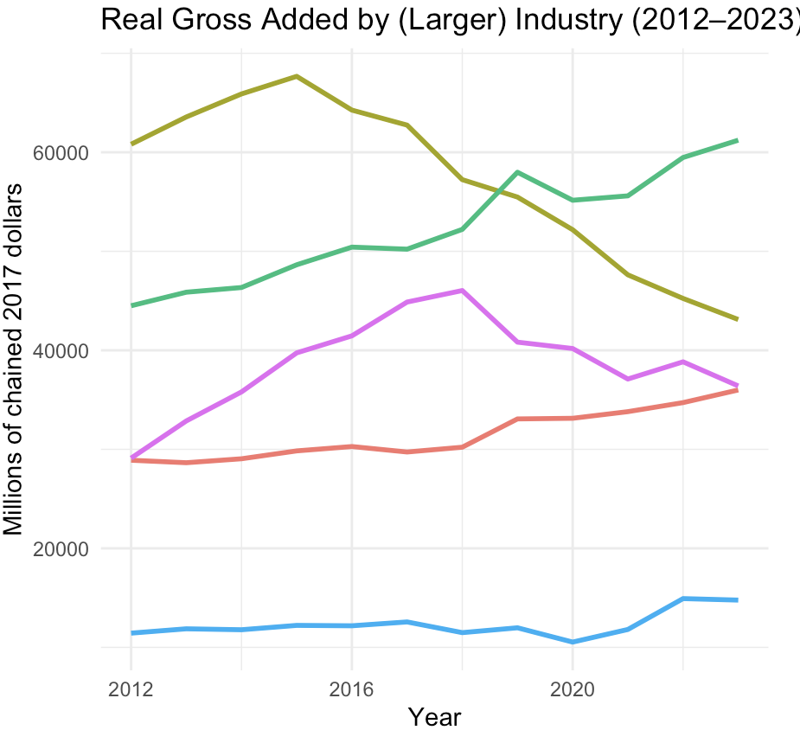
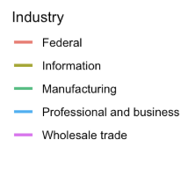
Notes:
KHUSHI: We wanted to first start by observing possible trends in the different industries. When we started making our visualizations to do this, we realized that it would be helpful to split the industries into two different pools to get a more accurate reading on trend lines. This is why we have two graphs each for Real Value Added and Real Gross Output by Industry which we split up by filtering outputs above and below 5000. Here, we have our 5 larger industries and their Real Value Added as well as their Real Gross Output from 2012 to 2023. From these graphs, we can observe that Space related manufacturing and federal spending stayed relatively stable - showing that they were more resilient than arts/retail which are more consumer driven, which we’ll see in the next slide. This stable demand from the government helped lessen the overall economic downturn, proving to be a large factor in the space economy's resilience, while industries like Wholesale Trade and Information Services experienced sharp declines in both RVA and RGO during 2020, space related manufacturing went in the other direction.

Slide 3
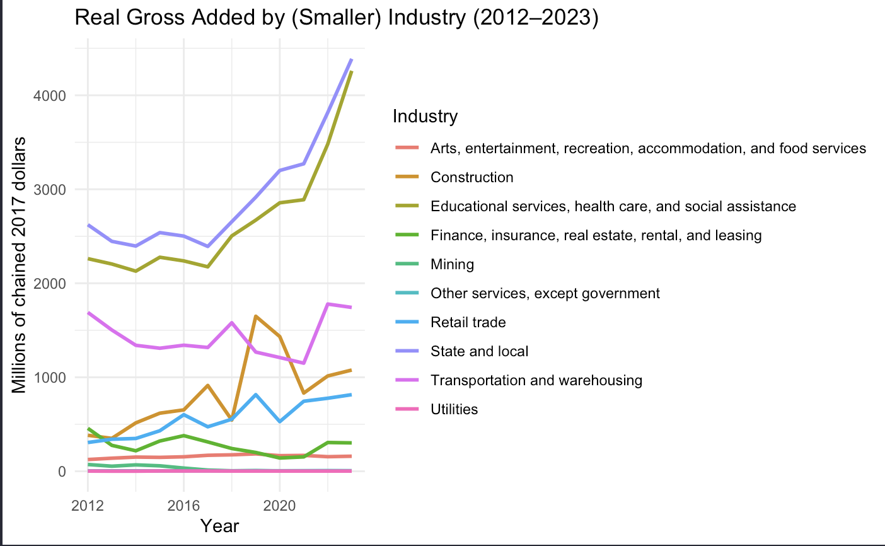
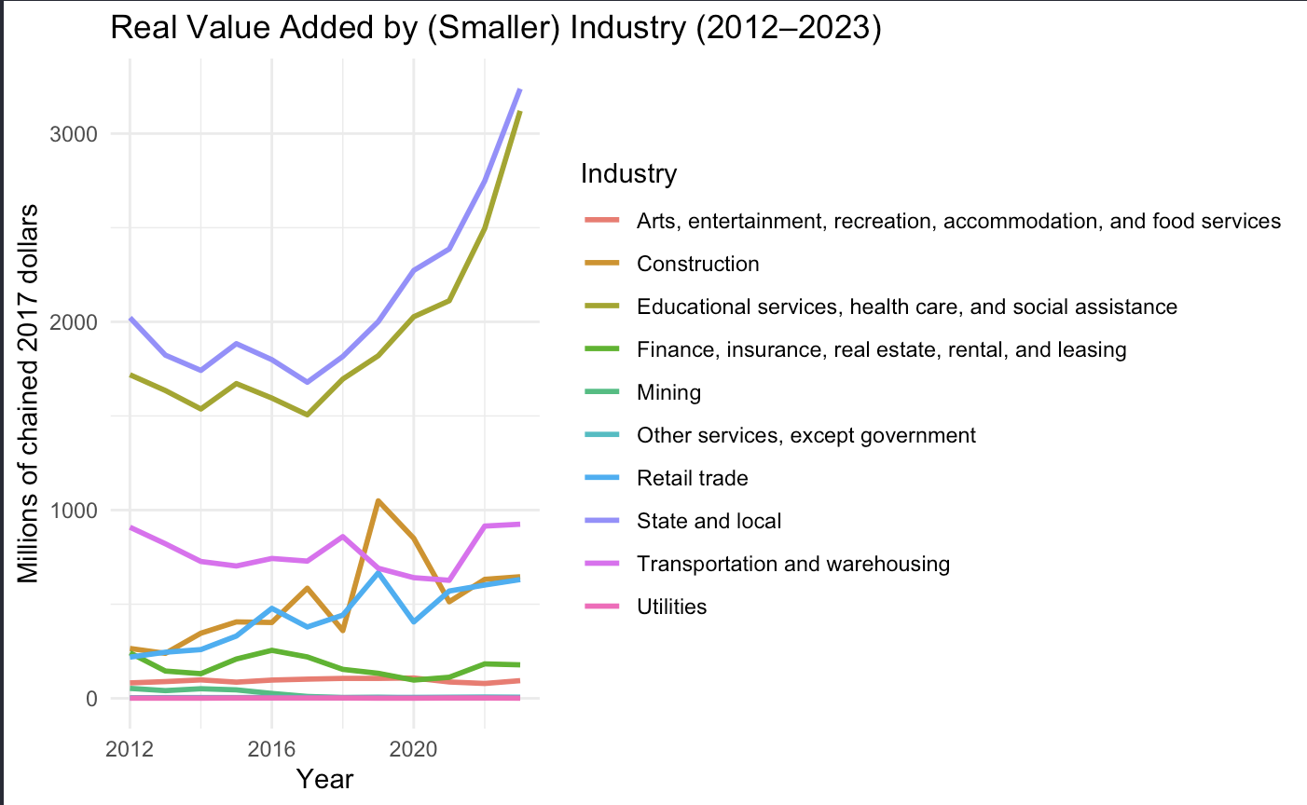
Notes:
Jiya: We did the same thing for the smaller industries. You can see Education & Health steadily rising, with an extra push after 2020, and Transportation & Warehousing climbing after a small dip after 2020—both good signals of real scaling. By contrast, the large service clusters tied to finance/real-estate and information-related activity trend downwards, possibly reflecting productivity gains, automation, or work shifting to fewer, higher-skilled roles. Retail and a handful of smaller categories stay low and can be choppy. We can compare this with the compensation chart on the next few slides, which demonstrates that payroll is up even where headcount is flat or down, which means rising wages and productivity.
For investors, that splits the opportunity: sectors like Education & Health and Transport & Warehousing are staffing up and expanding capacity, while areas with fewer workers but higher pay point to capital deepening—a good sign for equipment, software, and high-skill services rather than labor growth.

Slide 4
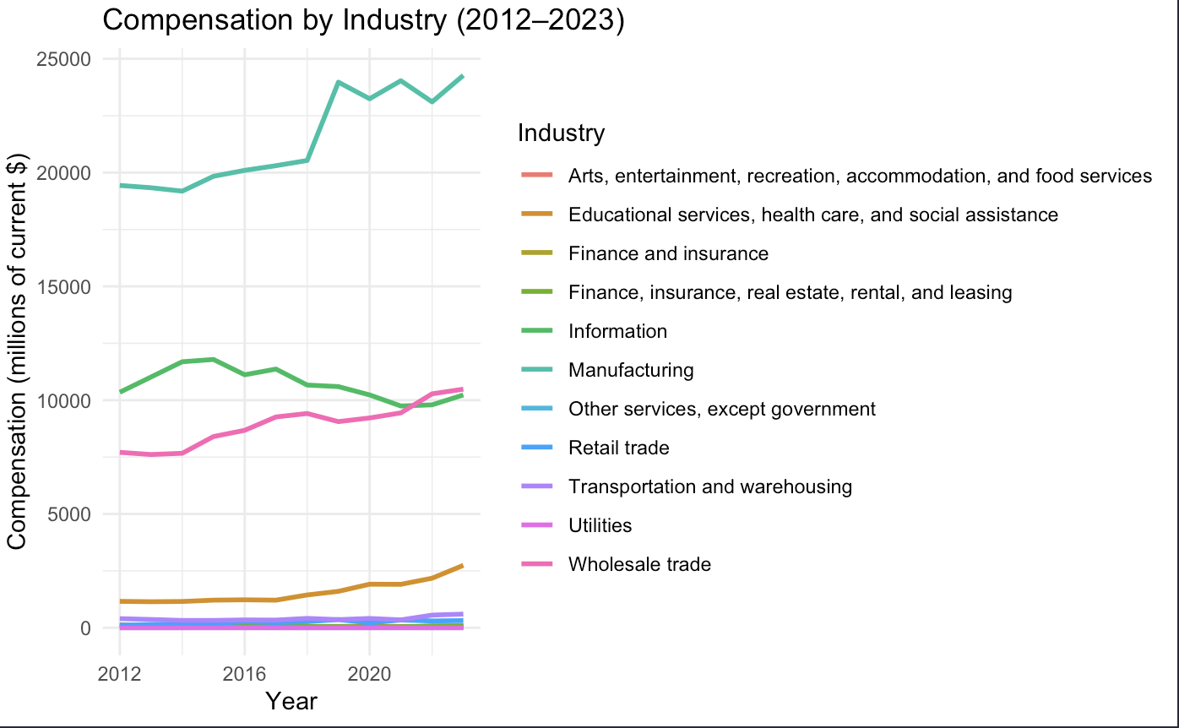
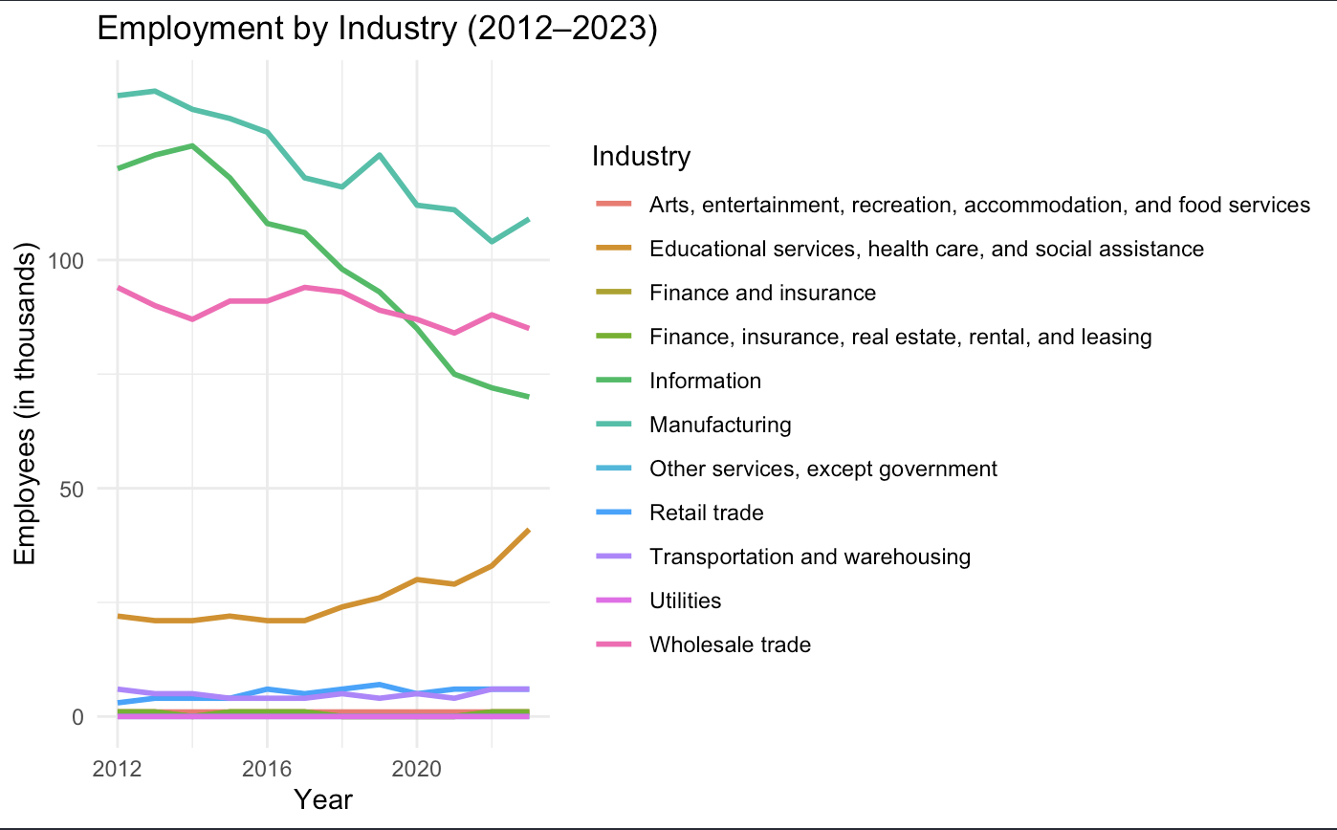
Notes:
Srinidhi: This visualization comes from the compensation table showing the total payroll by industry from 2012-2023, in millions of current dollars. We can see from this that the finance-real estate industries is the most consistent and largest rise, especially after 2020. After that, we see information and manufacturing which finish 2023 above above their pre-COVID pay levels, while education and health consistently accelerates through the whole period with a boost after the pandemic. We can also see transportation and warehousing which starts from a lower compensation but experiences a pretty strong post COVID increase. By contrast, retail, arts and entertainment, utilities, and other parts of wholesale trade stay stagnant and mostly flat. The takeaway is that our resilience winners aren’t just producing more value—they’re expanding payrolls, which signals durable demand, capacity building, and a stronger long-term investment case.
In terms of employment: we can see that finance-related industries dominate in compensation but are losing workers, which suggests that rising wages or consolidation. Health and Education are steadily growing in both employment and compensation, signaling expansion and rising demand. Wholesale Trade is stable in employment but gaining in compensation—workers are being paid more over time. Most other industries remain small in both pay and employment, with little change.

Slide 5
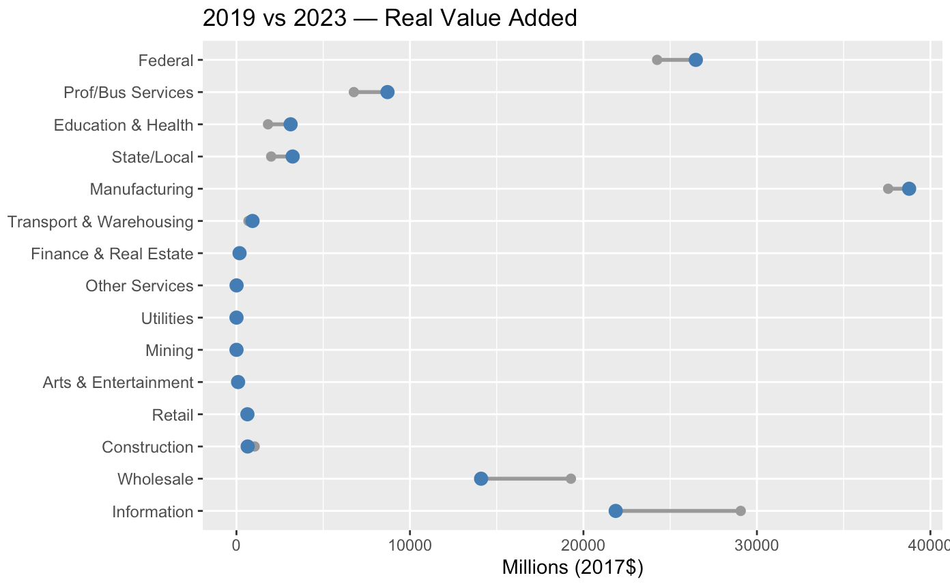
Notes:
Srinidhi: This plot compares each industry’s real value added in 2019 (gray) to 2023 (blue). If the blue dot sits to the right of the gray one, that industry is above its pre-COVID level; if it’s to the left, it’s still below 2019. Reading it this way, Manufacturing shows blue clearly to the right and at a large absolute scale strong long-term candidate. Federal also shifts right, signaling steady, resilient public spending and durable growth. Professional & Business Services and Education & Health both land to the right, indicating net gains since 2019. By contrast, Information and Wholesale Trade have blue to the left of gray, so they remain below pre-COVID levels and warrant caution. Construction, Retail, and Arts/Entertainment look flat to down versus 2019 unless you have a specific turnaround thesis. The leaders here—Manufacturing, Federal, Professional & Business Services, and Education & Health—match what we saw in the dip-and-rebound chart, so the two views agree on who looks most resilient and still growing.”

Slide 6
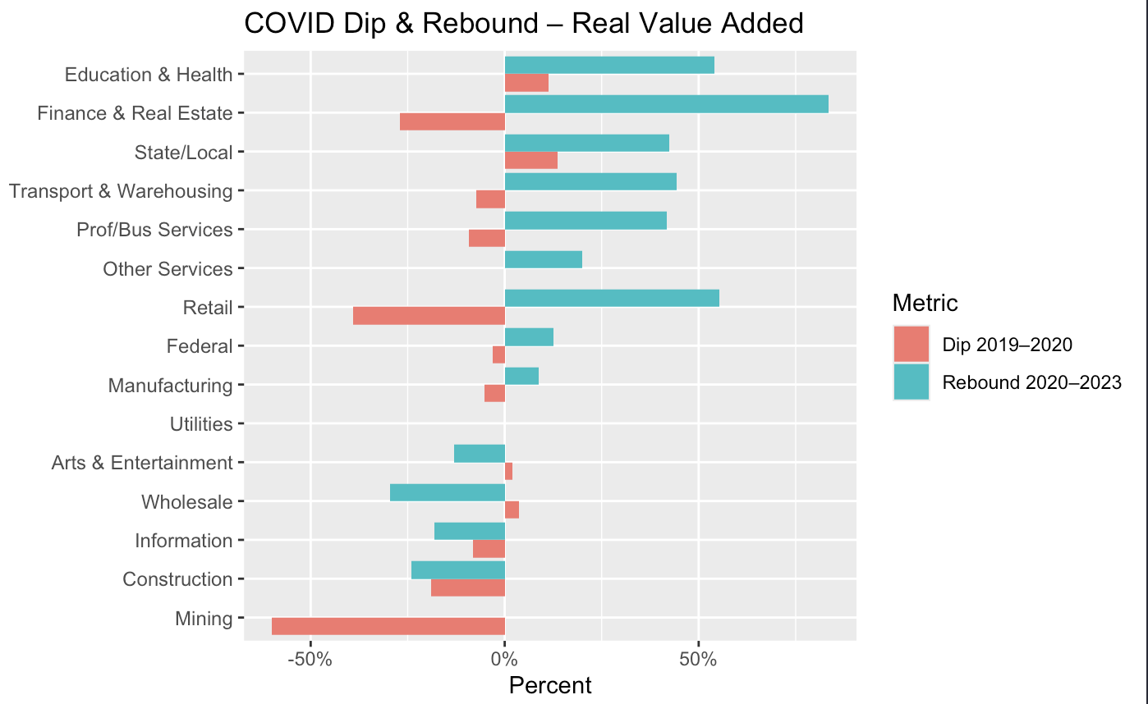
Notes:
Marianne: This chart is our COVID stress-test for each industry’s real value added. The red bar shows the drop from 2019 to 2020 when COVID hit, and the teal bar shows the rebound from 2020 to 2023. When the teal bar is longer than the red bar’s magnitude, that industry has more than fully recovered in real, inflation-adjusted terms. What we see is that transportation and warehousing, education and health, professional and business services, state and local government activity, and finance and real estate all took manageable hits and then bounced back strongly these are our leading candidates for resilient, sustainable growth. Manufacturing and federal spending look like defensive pillars: smaller dips and steady recoveries, big enough to anchor the space economy. Bottom line is the first group is compounding above pre-COVID levels, which is where long-horizon capital is most likely to keep working.

Slide 7
Final Conclusions
Strong fluctuations in the private industry after 2020
Information and wholesale trade declined sharply
Most others went up, manufacturing going up significantly
The Government sector, representing federal spending on space-related activities, was very stable. As seen in our RVA and RGO charts, its economic output remained consistent from 2012 to 2023.
Space related manufacturing and federal spending stayed relatively stable, which buffered the economy - showing that they were more resilient than arts/retail which are more consumer driven
The space economy's total private employment dipped from 2019 to 2021. However, total compensation within these industries continued going up, with only a very minor dip in 2020.
Government and Space-related manufacturing were the most resilient industries during the COVID-19 pandemic.

Slide 8
Main Recommendations!
Manufacturing stays strong against external forces, even rises higher after unexpected events
Government stays stable through it all
Consumer driven, such as arts and retail can be finicky, avoid under pressure
Overall workforce: stays skilled and value of total compensation did not decline proportionally to employment.

